Slide 1
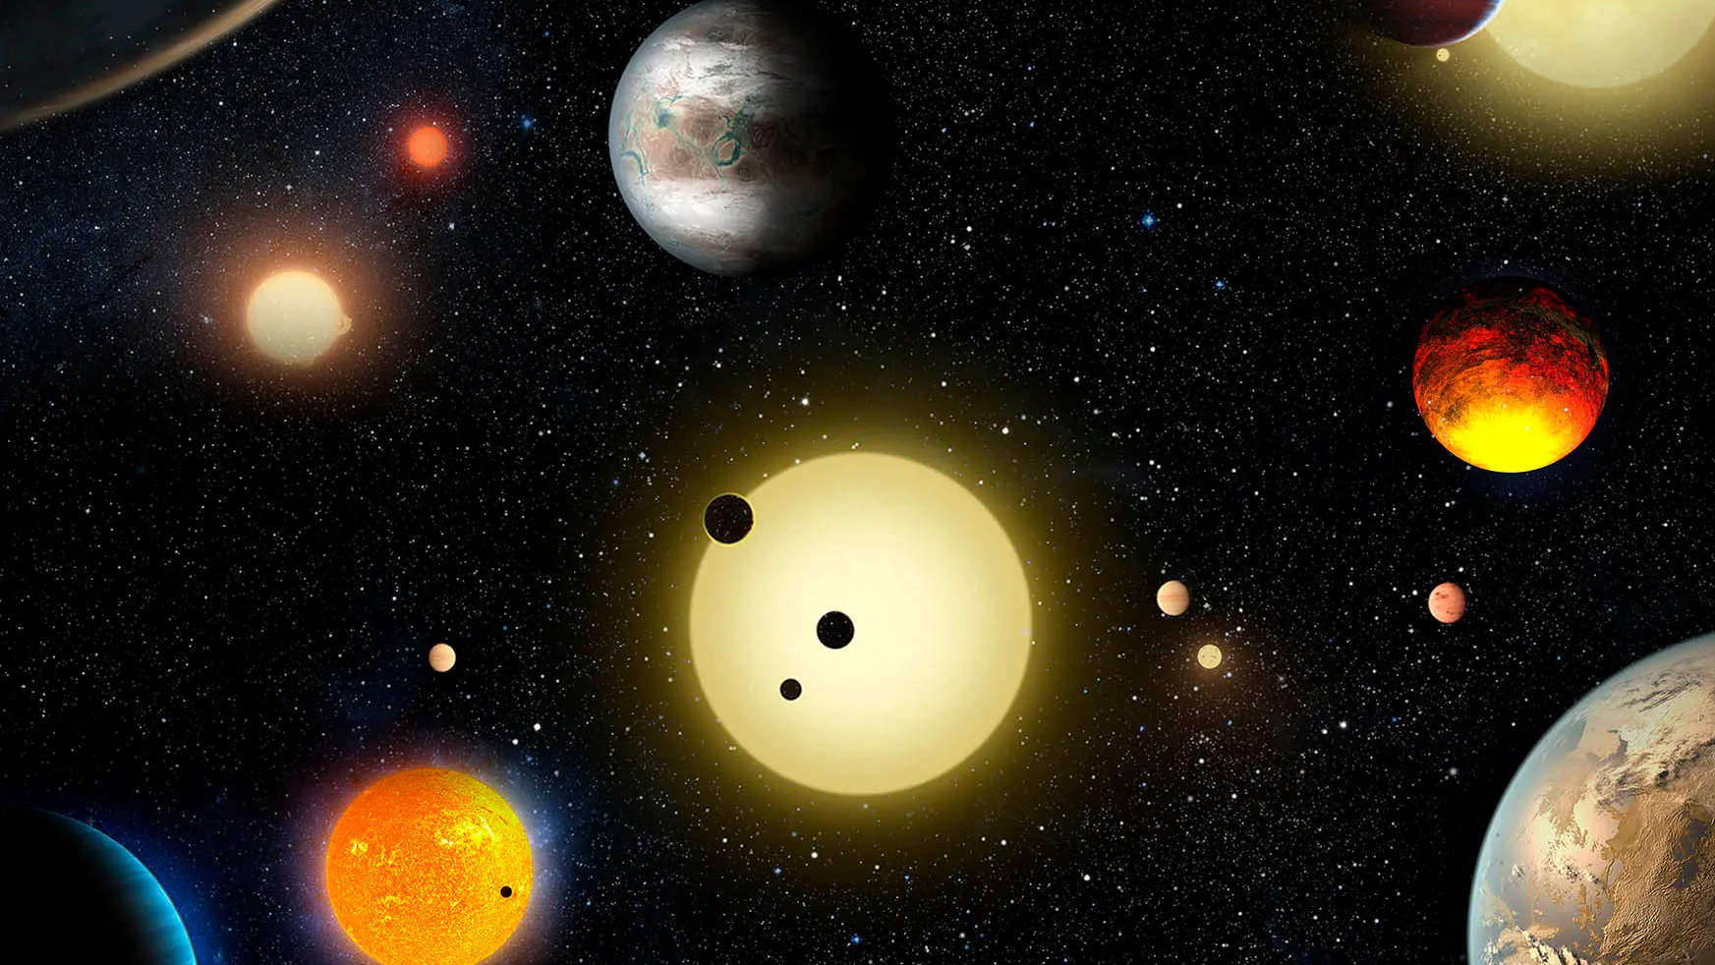
UNITED PLANET EXPLORER
UNITED KEYBOARDS
Aiman Ahmed
Muazar Mohammed
Aaron Muthali
Kamil Mokaddem
Zayedul Hoque Mallick

Slide 2

Current exoplanet detection relies on manual analysis of Massive Datasets. We propose multiple ML models trained on NASA’s datasets to automate and enhance detection accuracy.
Why is it Important? Handling Massive Data Volume Accelerating Discovery Finding Fainter Signals Answering Fundamental Questions

Slide 3
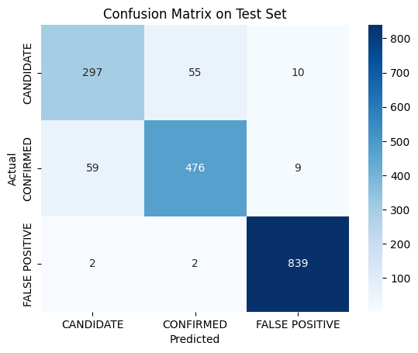
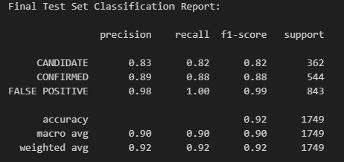
Multi-Model ML System: Trains multiple models on NASA’s open datasets.
Automated Detection: Analyzes light curves to identify exoplanets instantly.
Combined Datasets: Combines Datasets to increase accuracy and reliability.
Smart Feature Extraction: Detects subtle brightness dips in stars.
Continuous Learning: Improves with new mission data.
Visual Dashboard: Shows detection results and confidence levels.

Slide 4

Google Cloud , Chatgpt , Gemini. Databases from NASA Kepler Objects of Interest (KOI) TESS Objects of Interest (TOI) Assessment of Ensemble-Based Machine Learning Algorithms for Exoplanet Identification Visual Studio Code Python

Slide 6
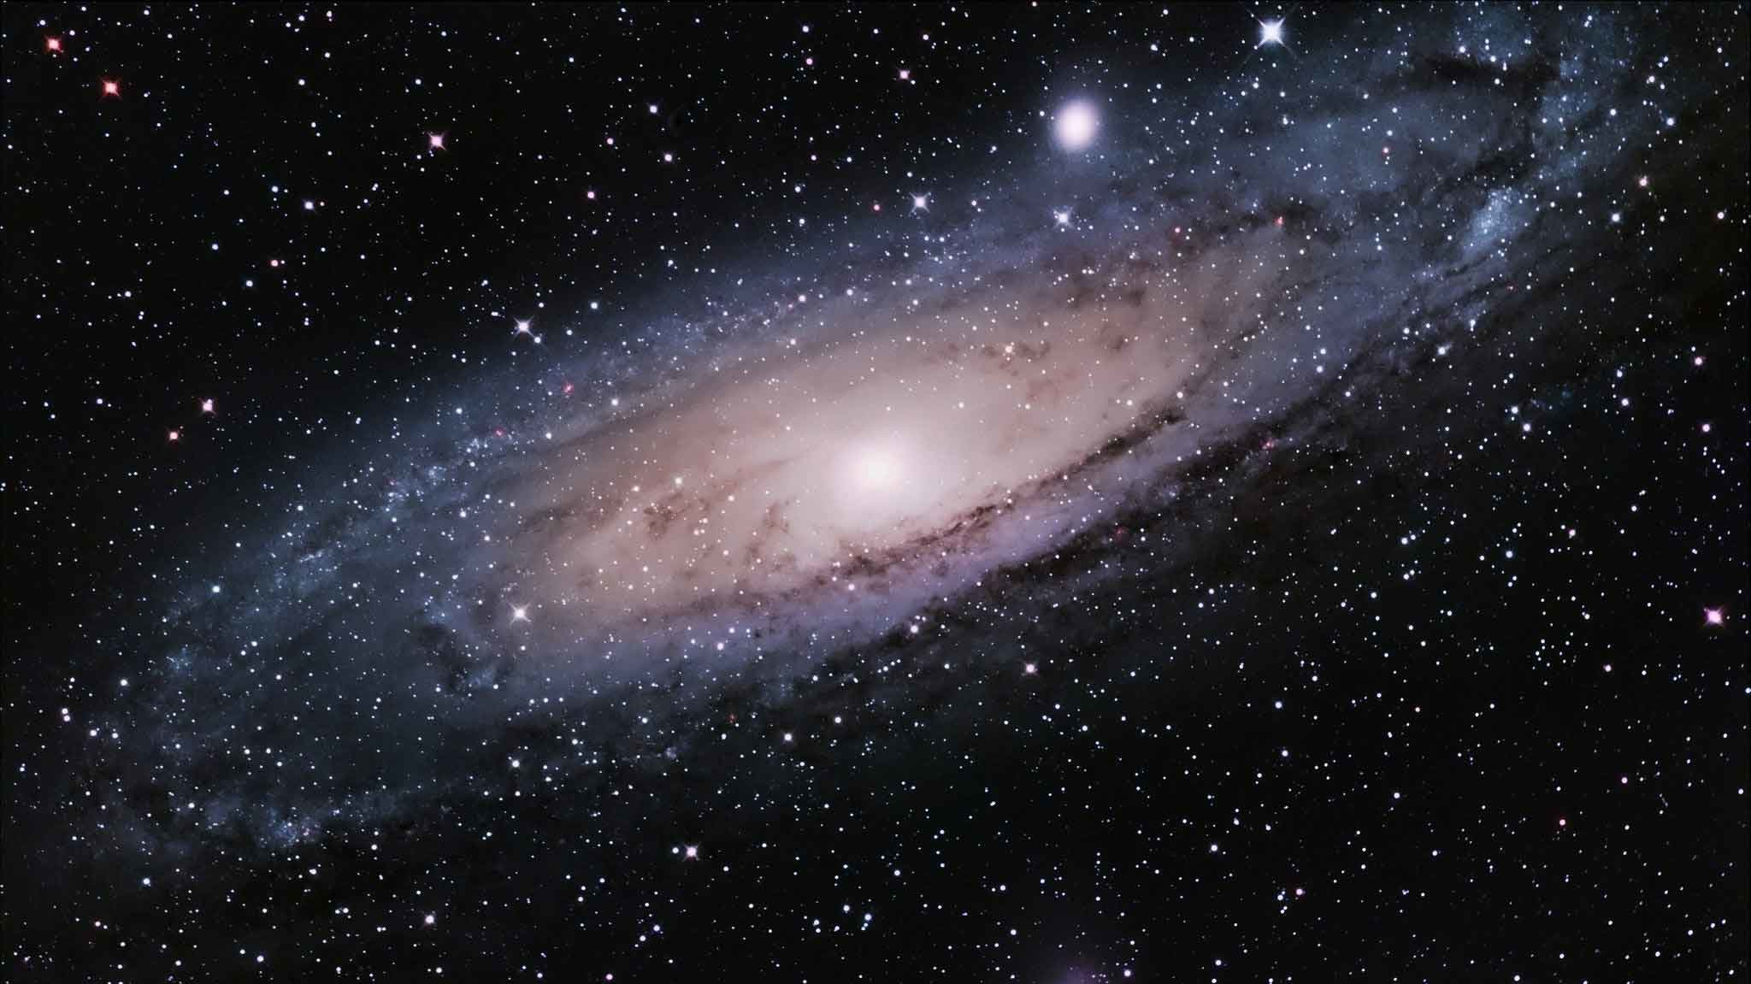
🌍 Who Benefits & Alignment with NASA Goals
Astronomers & Researchers: Faster, more accurate exoplanet detection.
NASA & Space Missions: Supports data-driven exploration and discovery.
Scientific Community: Enables open-source collaboration and innovation.
Global Impact: Promotes use of AI for sustainable space research.
Alignment with NASA Goals: Advances astrophysics through automation and enhances understanding of habitable worlds.

Slide 7
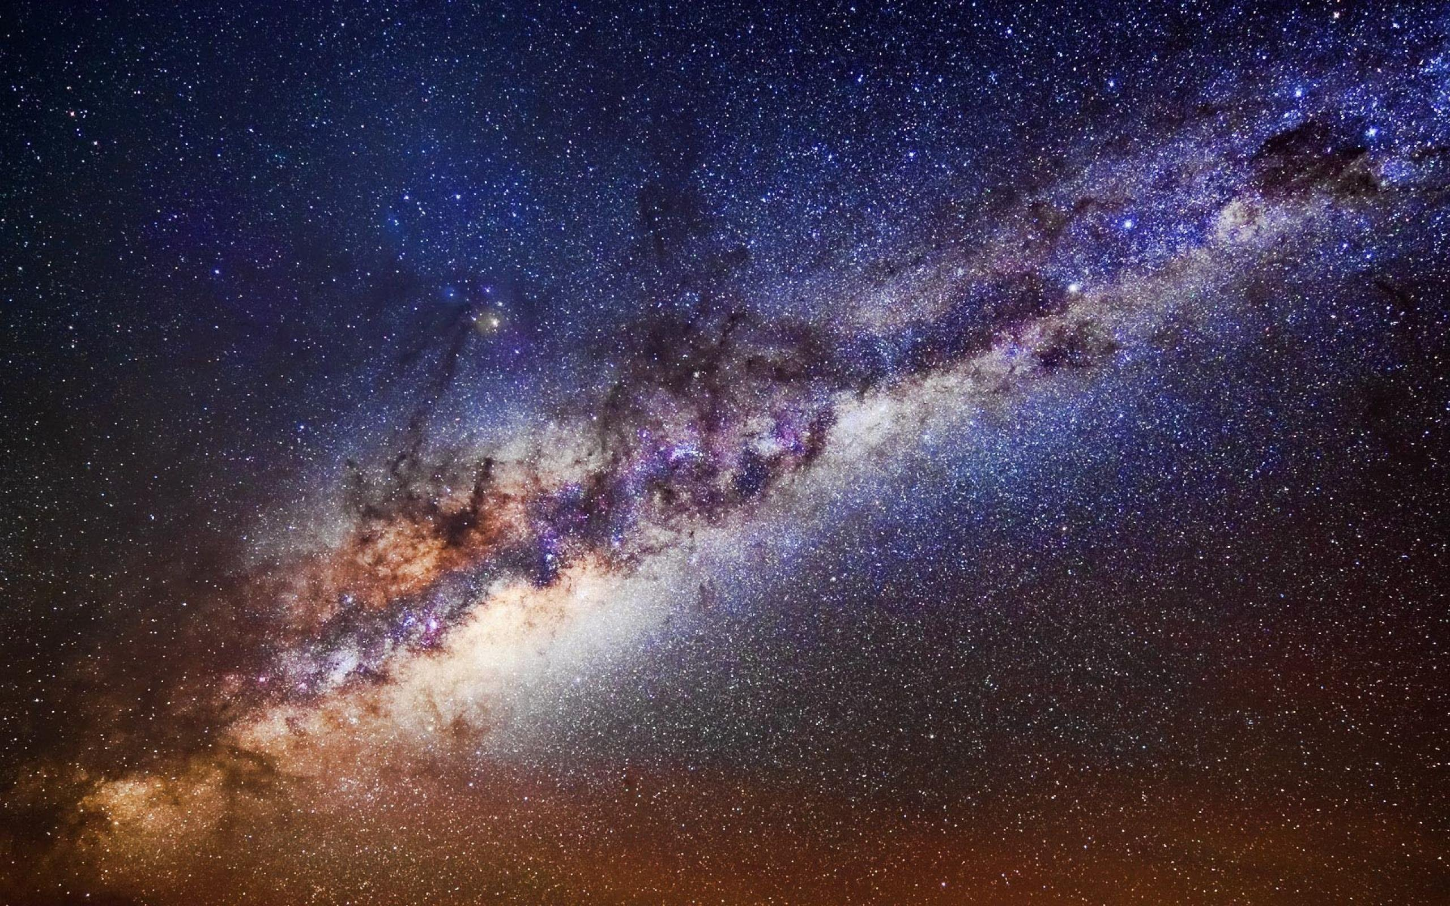
🔭 What’s Next
Expand model training with more NASA mission data (Kepler, TESS, JWST).
Deploy as an open-source tool for the global research community.
Integrate real-time data analysis for future exoplanet discoveries.
“By combining space science with artificial intelligence, we move closer to uncovering new worlds — and understanding our place in the universe.”

Slide 8


